Slide 1
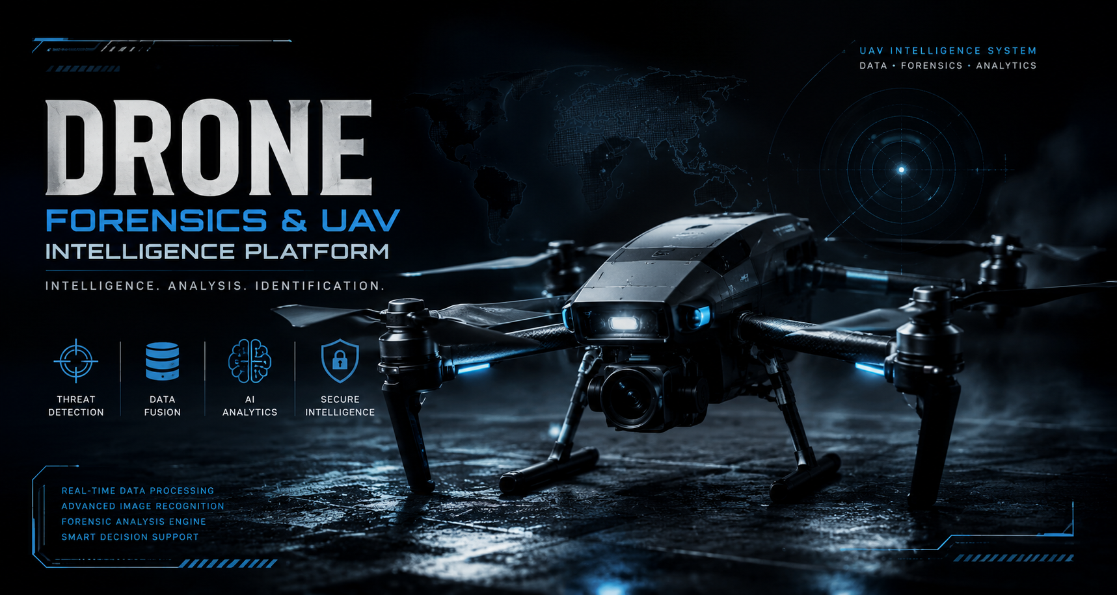
FORENSICS & DEFENSE INTELLIGENCE
Abhijot Singh (2203391)

Slide 2



PROBLEM STATEMENT & OBJECTIVES
The UAV Intelligence Gap
Tactical Platform Objectives
Current defense and commercial UAV assessment workflows suffer from fragmentation and manual overhead:
Architecting an integrated AI-driven pipeline to automate drone hardware analysis and forensics:
UAV component details are scattered across disparate manufacturer sites.
Establish a fully centralized UAV intelligence & hardware repository.
Implement a specialized automated hardware compatibility engine.
Critical component compatibility relies on highly error-prone manual verification.
Deploy predictive ML models for dynamic drone configuration.
Absence of an integrated, highly centralized UAV digital intelligence repository.
Integrate advanced computer vision for UAV model identification.
Deploy a robust, locally hosted AI analyst assistant (Ollama / Phi-3).
A severe lack of AI-driven tools to assist investigators with real-time drone analysis.

Slide 3









SYSTEM ARCHITECTURE
Multi-Tier Technology Stack
The Drone Forensics and UAV Intelligence Platform follows a modular architecture integrating web technologies, database systems, machine learning, computer vision, and AI-powered assistance into a unified platform.
Frontend Layer
Built using React.js to provide responsive user interfaces for UAV intelligence management, compatibility validation, recommendations, image recognition, and AI interactions.
Backend Layer
Developed using Node.js and Express.js to handle REST APIs, data processing, and communication between application modules.
Database Layer
Implemented using MySQL with 40+ relational tables for UAV manufacturers, platforms, variants, components, compatibility datasets, and user management.

Slide 4







DATABASE & DATA COLLECTION
40+ Relational Database Tables
CSV Pipeline Workflow
Designed a highly normalized database schema mapping the entire ecosystem of micro-UAV physical components:
A scalable ingestion framework developed to automate population of UAV intelligence and component datasets from multiple sources.
Pipeline Features:
Bulk CSV Import: Supports thousands of records per upload.
Staging Tables: Temporary validation layer before database insertion.
Data Cleaning: Removes duplicates and standardizes specifications.
Validation Rules: Checks missing values, data types, and relationships.
Automated Mapping: Transfers validated records into production tables.
Error Logging: Tracks invalid or rejected entries for review.
Key Features:
UAV Manufacturers & Platform Management
Component Inventory (Motors, ESCs, Batteries, Frames, Propellers, Flight Controllers, GPS, Cameras, VTX)
Compatibility Mapping Tables
Recommendation Training Dataset Storage
Firmware & Software Repository
User & Search Activity Management
Additionally, aggregates component blueprints from active Indian and foreign UAV manufacturers and hardware standardizations.

Slide 5

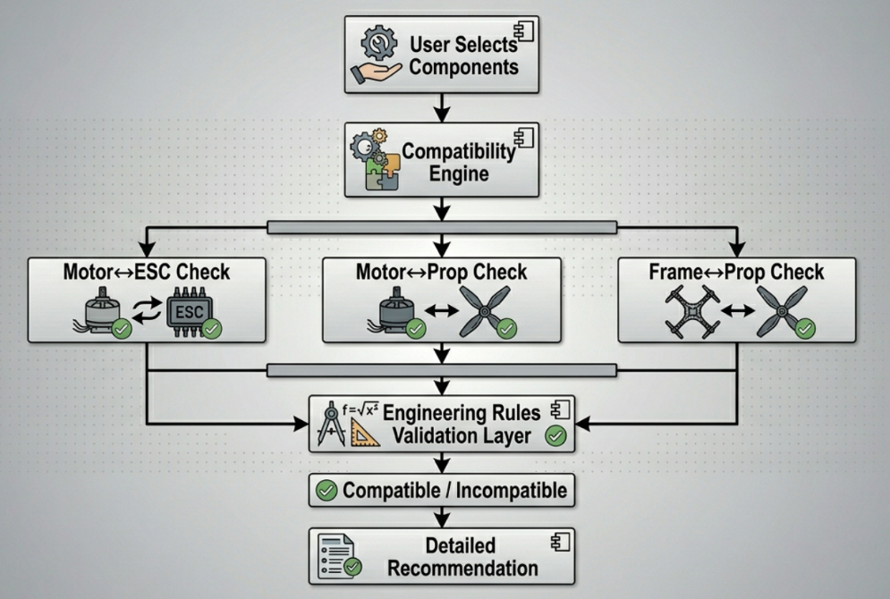
COMPATIBILITY VALIDATION ENGINE
Advanced Validation Matrix
The engine performs physical calculations mapping electrical and mechanical tolerances of proposed multirotors:
Motor ↔ ESC: Evaluates peak current draw (Amps) against the speed controller's maximum sustained ratings.
Motor ↔ Propeller: Calculates thrust output curve to guarantee the motor can safely spin the blade without overheating.
Frame ↔ Propeller: Uses physical geometry equations to confirm the propeller diameter will not hit the UAV arm.
Platform Benefits:
Reduces UAV build errors.
Saves component selection time.
Improves reliability of custom UAV configurations.

Slide 6


ML RECOMMENDATION ENGINE
TensorFlow.js Powered Model
Leverages local, privacy-centric AI to predict the best companion components based on drone performance envelopes:
Feature Engineering: Extracts weight-to-thrust ratio, battery C-ratings, and kv-ratings to train local models.
Predictive Matching: Dynamically recommends matching components when target component matches are out of stock.
Deterministic Pipeline: Combining neural nets with hardware rule boundaries for safe recommendations.
Workflow: User Input Selection ➔ ML Pipeline Engine ➔ Recommended Components
Benefits:
✔ Faster Component Selection
✔ Intelligent UAV Build Assistance
✔ Reduced Manual Analysis
✔ Improved Configuration Accuracy

Slide 7
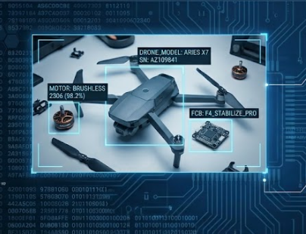
IMAGE RECOGNITION MODULE
Intelligent Vision & OCR
Built using OpenCV and EasyOCR to automatically extract information from UAV images and identify relevant drone components.
Key Features:
Text Extraction: Extracts manufacturer names, model numbers, and component labels from uploaded images.
Image Preprocessing: Uses grayscale conversion, thresholding, resizing, and noise reduction to improve OCR accuracy.
Information Retrieval: Displays relevant UAV intelligence records based on recognized text.
Flow: Upload Image ➔ Preprocessing ➔ OCR Extraction ➔ Information Retrieval

Slide 8


AI ASSISTANT MODULE
On-Premises LLM Integration
The AI Assistant module provides intelligent guidance and information retrieval support for UAV-related queries using a locally deployed language model.
Key Features
Ollama Integration: Enables local deployment and execution of AI models within the platform.
Phi-3 Language Model: Processes user queries and generates contextual responses.
Technical Guidance: Assists users with UAV components, specifications, compatibility, and troubleshooting queries.
Knowledge Assistance: Supports information retrieval from the UAV intelligence ecosystem.
Ollama • Phi-3 • React • Node.js • REST APIs
"How do I determine if a T-Motor F60 Pro IV is compatible with an APC 5x4.3x3 propeller?"

Slide 9
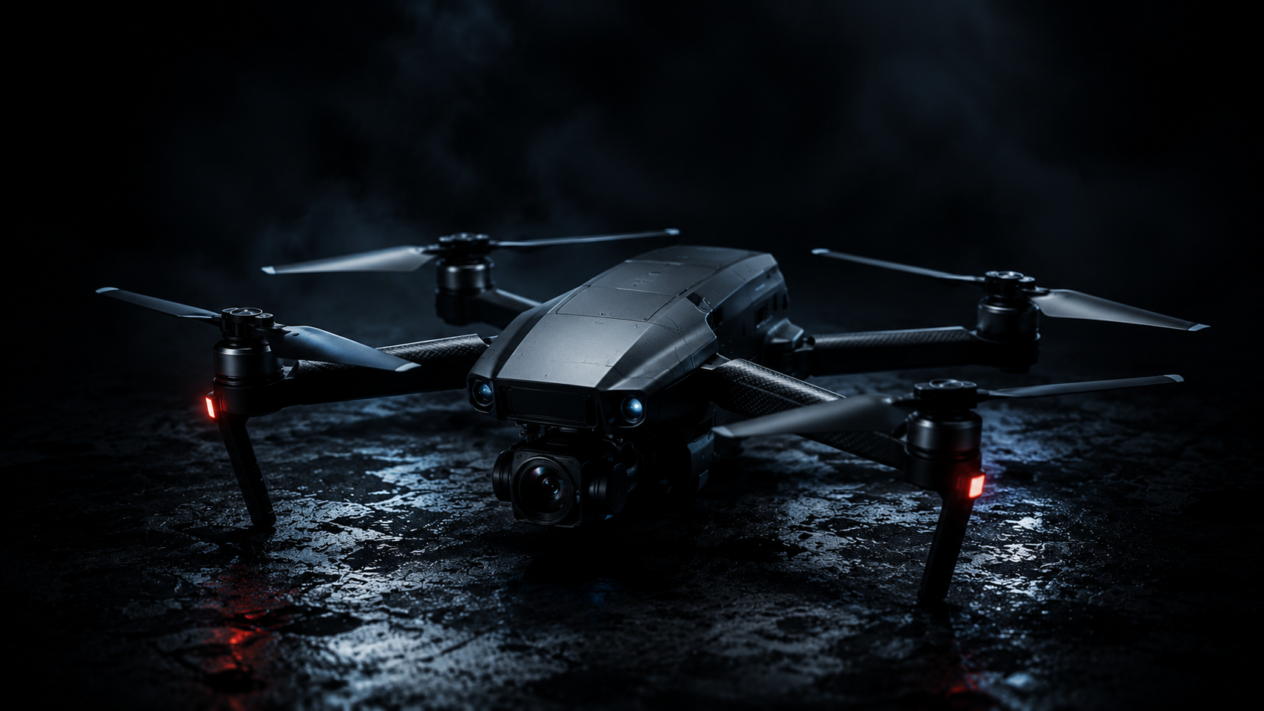

PLATFORM RESULTS & IMPACT
Successfully Developed Systems
Complete UAV Intelligence Relational Database
Automated Multi-Source CSV Ingestion Engine
Electrical & Mechanical Compatibility Validation Engine
TF.js Component Recommendation Model
Robust OCR Serial Number Extraction Tool
On-Premises AI Intelligence Chatbot Interface
Key Forensics Benefits:
➔ Faster Hardware Analysis • Reduced Manual Error • Data-Driven Intelligence
Platform Achievements
40+ Relational Database Tables Implemented
1,000+ UAV & Component Records Managed
Automated Compatibility Verification Workflows
Integrated AI, ML, OCR & Database Ecosystem
Successfully developed an end-to-end intelligent UAV analysis platform integrating Database Management, Compatibility Validation, Machine Learning, Computer Vision, and Generative AI technologies.

Slide 10
DISCUSSION
Unified Platform
By bringing together intelligence records, component data, forensic utilities, and AI support, the system removes the fragmentation common in existing UAV resources.
Decision Support
Compatibility checks and machine-learning recommendations turn the platform from passive storage into active guidance for safer, more informed build choices.
Security and Reliability
Offline-first operation reduces exposure to external service dependency, which is especially valuable in controlled, sensitive, or disconnected environments.
Scalable Maintainability
A modular structure plus CSV ingestion make future extension practical, allowing new datasets and models to be added with limited disruption.

Slide 11

CONCLUSION & FUTURE SCOPE
Strategic Conclusion
Engineering Future Scope
Successfully developed a centralized Drone Forensics and UAV Intelligence Platform integrating UAV intelligence management, component compatibility validation, machine learning recommendations, image recognition, and AI-assisted guidance into a single web-based system.
The platform utilizes a structured MySQL database, CSV ingestion pipelines, TensorFlow.js recommendation models, OpenCV-EasyOCR image processing, and Ollama-powered AI assistance to improve UAV information retrieval and decision-making.
Key Outcomes
✔ Centralized UAV Intelligence Repository
✔ Automated Compatibility Validation Engine
✔ Machine Learning Recommendation System
✔ OCR-Based UAV Identification Support
✔ AI-Powered Technical Assistance
Real-Time UAV Intelligence Updates
Integrate live UAV and component information feeds from manufacturers and industry sources.
Enhanced Machine Learning Models
Train larger datasets and improve recommendation accuracy using advanced ML techniques.
Advanced Computer Vision
Extend image recognition capabilities to support automatic UAV model classification.
Interactive Build Planner
Allow users to design complete UAV configurations with real-time compatibility and recommendation support.
Expanded Component Ecosystem
Include additional UAV hardware categories, firmware repositories, and operational datasets.

